Slide 1

1
EEG CLASSIFACTION USING TEXT COMPRESION
Authors:- Mohammad Khateeb , Jad Taha
Advisors:- Dr. Samah Idrees Ghazawi ,Dr. Anat Dahan
Link to Github:- https://github.com/mhmdkh1905/EEG-recordings.git
Code Project:- 25-1-R-2

Slide 2



2
Abstract
Problem
Goal
Approach
ADHD affects attention and behavior, making diagnosis essential.
Use EEG recordings and text compression methods to classify ADHD-related brain activity.
Improve the accuracy of ADHD classification and contribute to better diagnostic tools.

Slide 3
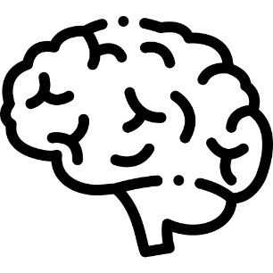
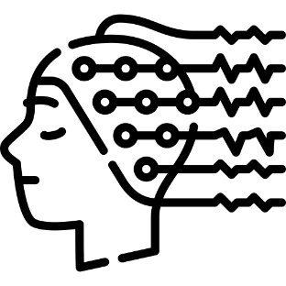

3
Introduction to EEG
Electroencephalography
01
02
What is EEG?
How EEG Works?
EEG measures electrical activity in the brain.
It is non-invasive, requiring no surgery or direct contact with brain tissue.
What is EEG?
How EEG Works?
Electrodes on the Scalp: Detect electrical signals from neurons.
Signal Detection: Captures tiny signals and processes them.
Data Processing: Signals are amplified and displayed as waveforms.
03
Purpose
Purpose
Helps understand brain activity and diagnose neurological conditions

Slide 4
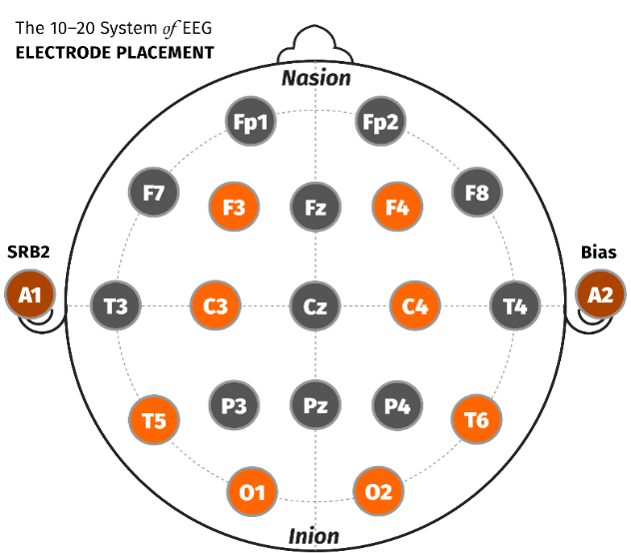
4
Introduction to EEG
Electroencephalography
The 10-20 Electrode Placement System
Purpose: Ensures accurate and consistent electrode placement for EEG.
Landmarks: Uses head features like the bridge of the nose, back of the head, and points near the ears.
Benefit: Provides a clear and structured view of brain activity.
F (Frontal), T (Temporal), C (Central),
P (Parietal), O (Occipital).
Odd = Left hemisphere, Even = Right hemisphere, Z = Midline.

Slide 5



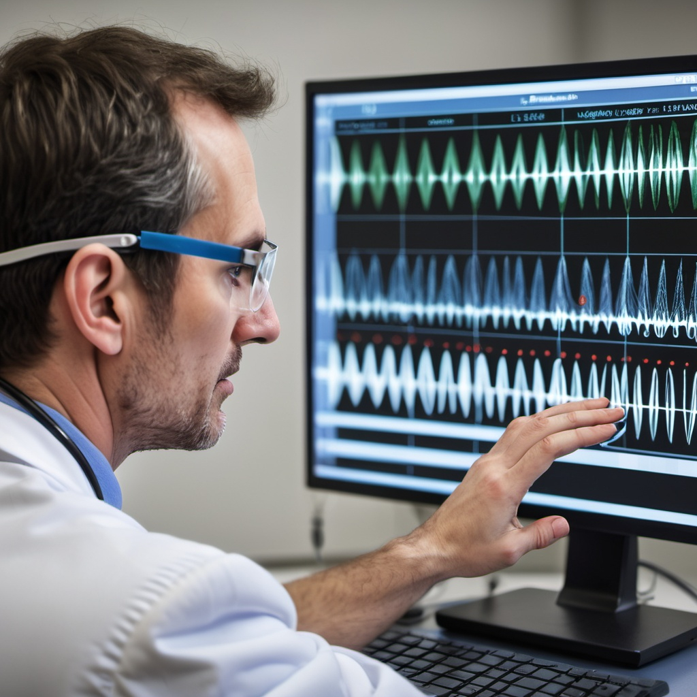
5
Introduction to EEG
Electroencephalography
Applications of EEG
01
Clinical Use
Diagnoses conditions like epilepsy, ADHD, and sleep disorders.
02
Research Use
Studies brain activity during tasks like memory recall and decision-making.
03
Emerging Fields
Brain-computer interfaces for direct communication between the brain and machines.

Slide 6
6
Introduction to ADHD

Slide 7

7
Introduction to ADHD
Attention-Deficit/Hyperactivity Disorder
What is ADHD?
Definition: A condition affecting focus, activity levels, and impulse control.
Common Symptoms: Trouble paying attention, being overly active, acting without thinking.
Impact: Challenges daily tasks, school, and work.
Prevalence of ADHD:
Common Disorder: ADHD affects about 5% of kids and teens worldwide.
Lifelong Condition: Often continues into adulthood.
Effects: Influences education, work, and relationships.

Slide 8
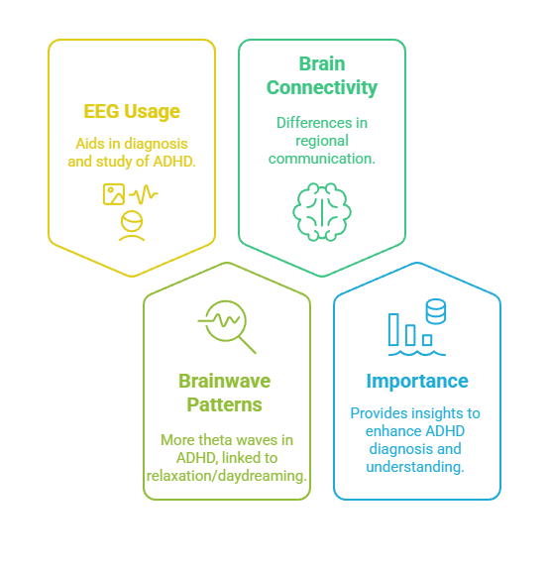
8
Introduction to ADHD
Attention-Deficit/Hyperactivity Disorder
EEG and ADHD
Measures brain activity.
Helps study ADHD and its effects.
Different patterns in ADHD brains.
Regions interact differently compared to non-ADHD brains.
Increased theta wave activity in ADHD.
Theta linked to relaxation and daydreaming.
Improves ADHD understanding.
Supports better diagnosis and treatment.

Slide 9
9
Dataset Overview

Slide 10
10
Dataset Overview
Participant
1
Medication | Age Range | Number of Participants | Group
Ritalin (up to 6 months) | 7-12 years | 60 | ADHD
None | 7-12 years | 60 | Healthy Controls

Slide 11
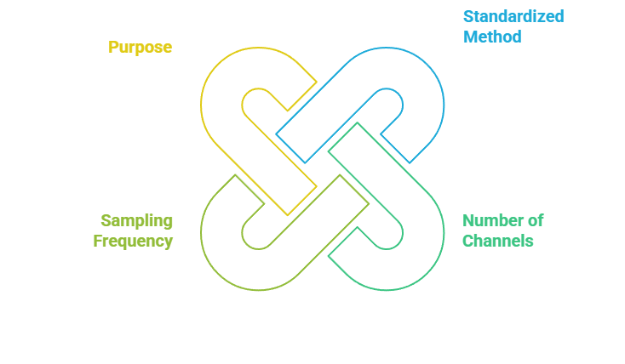
11
Dataset Overview
EEG Recording Details for each participant
2

Slide 12
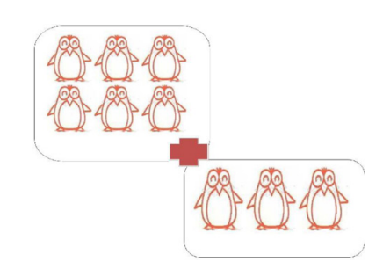
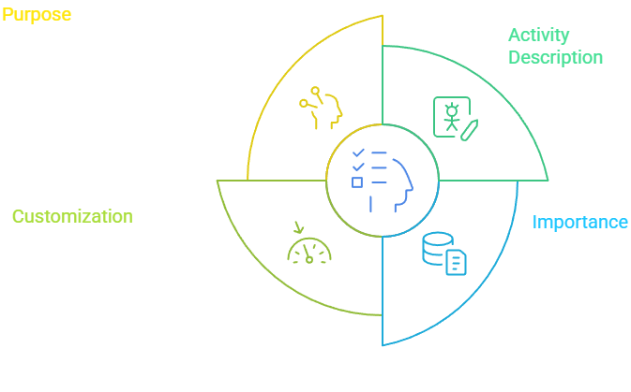
12
Dataset Overview
Visual Attention Task
3
The task was designed to stimulate cognitive processing and test attention.
Children were shown images of cartoon characters and asked to count the characters in each image.
The activity was adjusted to each child’s response speed for engagement and consistent data collection.
This task ensured a robust dataset for analyzing attention and focus in children with ADHD.

Slide 13
13
Introduction to Text Compression

Slide 14
14
Introduction to Text Compression
What is Text Compression?
1
Definition:
A method to reduce the size of text files or data while keeping the content intact.
Benefits:
Saves storage space.
Allows faster data transmission.
Why It’s Important:
Especially useful for handling large datasets.
Improves speed and efficiency.

Slide 15
15
Introduction to Text Compression
Beyond Compression
2
More than Space Saving:
Text compression can compare different types of data (e.g., text, signals, sequences).
How It Works:
Measures how compressible two objects are together to determine their similarity.
Applications:
Helps solve problems like classification, clustering, and pattern recognition by identifying shared patterns in data.

Slide 16

16
Introduction to Text Compression
Formulas Used
3
Normalized Compression Distance
This measures the similarity between two objects based on how much information they share. A lower value means the objects are more similar.

Slide 17
17
Our solution

Slide 18
18
Our solution
Preprocessing
1
Purpose:
Clean raw EEG recordings to ensure data quality.
Noise Reduction:
Remove noise and artifacts while preserving important brain signals.
Goal:
Prepare the data for accurate analysis by maintaining the integrity of the original signals.

Slide 19
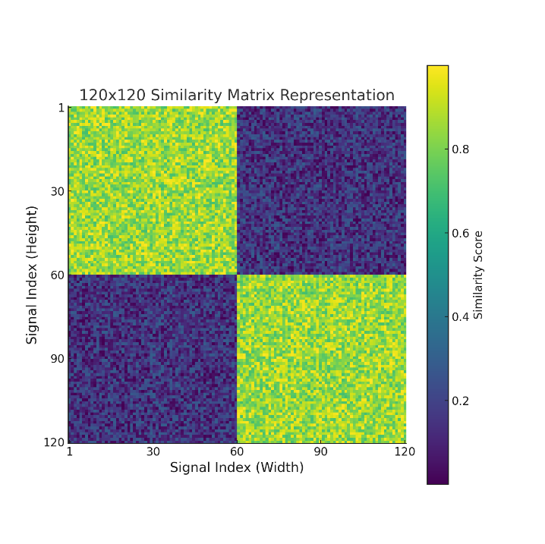
19
Our solution
Similarity Matrix Construction
2
Process:
Build a 120x120 similarity matrix for each of the 19 EEG channels.
Matrix Details:
Each cell in the matrix shows the similarity score between two signals.
How It Works:
Compare signals using a text compression algorithm.
Output:
Create 19 matrices, each representing the relationships within a specific channel.

Slide 20
20
Our solution
Classification
3
Pattern Analysis:
Analyze patterns in the similarity matrices to classify signals.
Group Classification:
Group signals with similar patterns to identify if a participant belongs to the ADHD or Typically Developing group.
Comprehensive Process:
Repeat the classification across all 19 EEG channels for consistency.
Final Step:
Combine the results from all channels to make an accurate final classification.

Slide 21
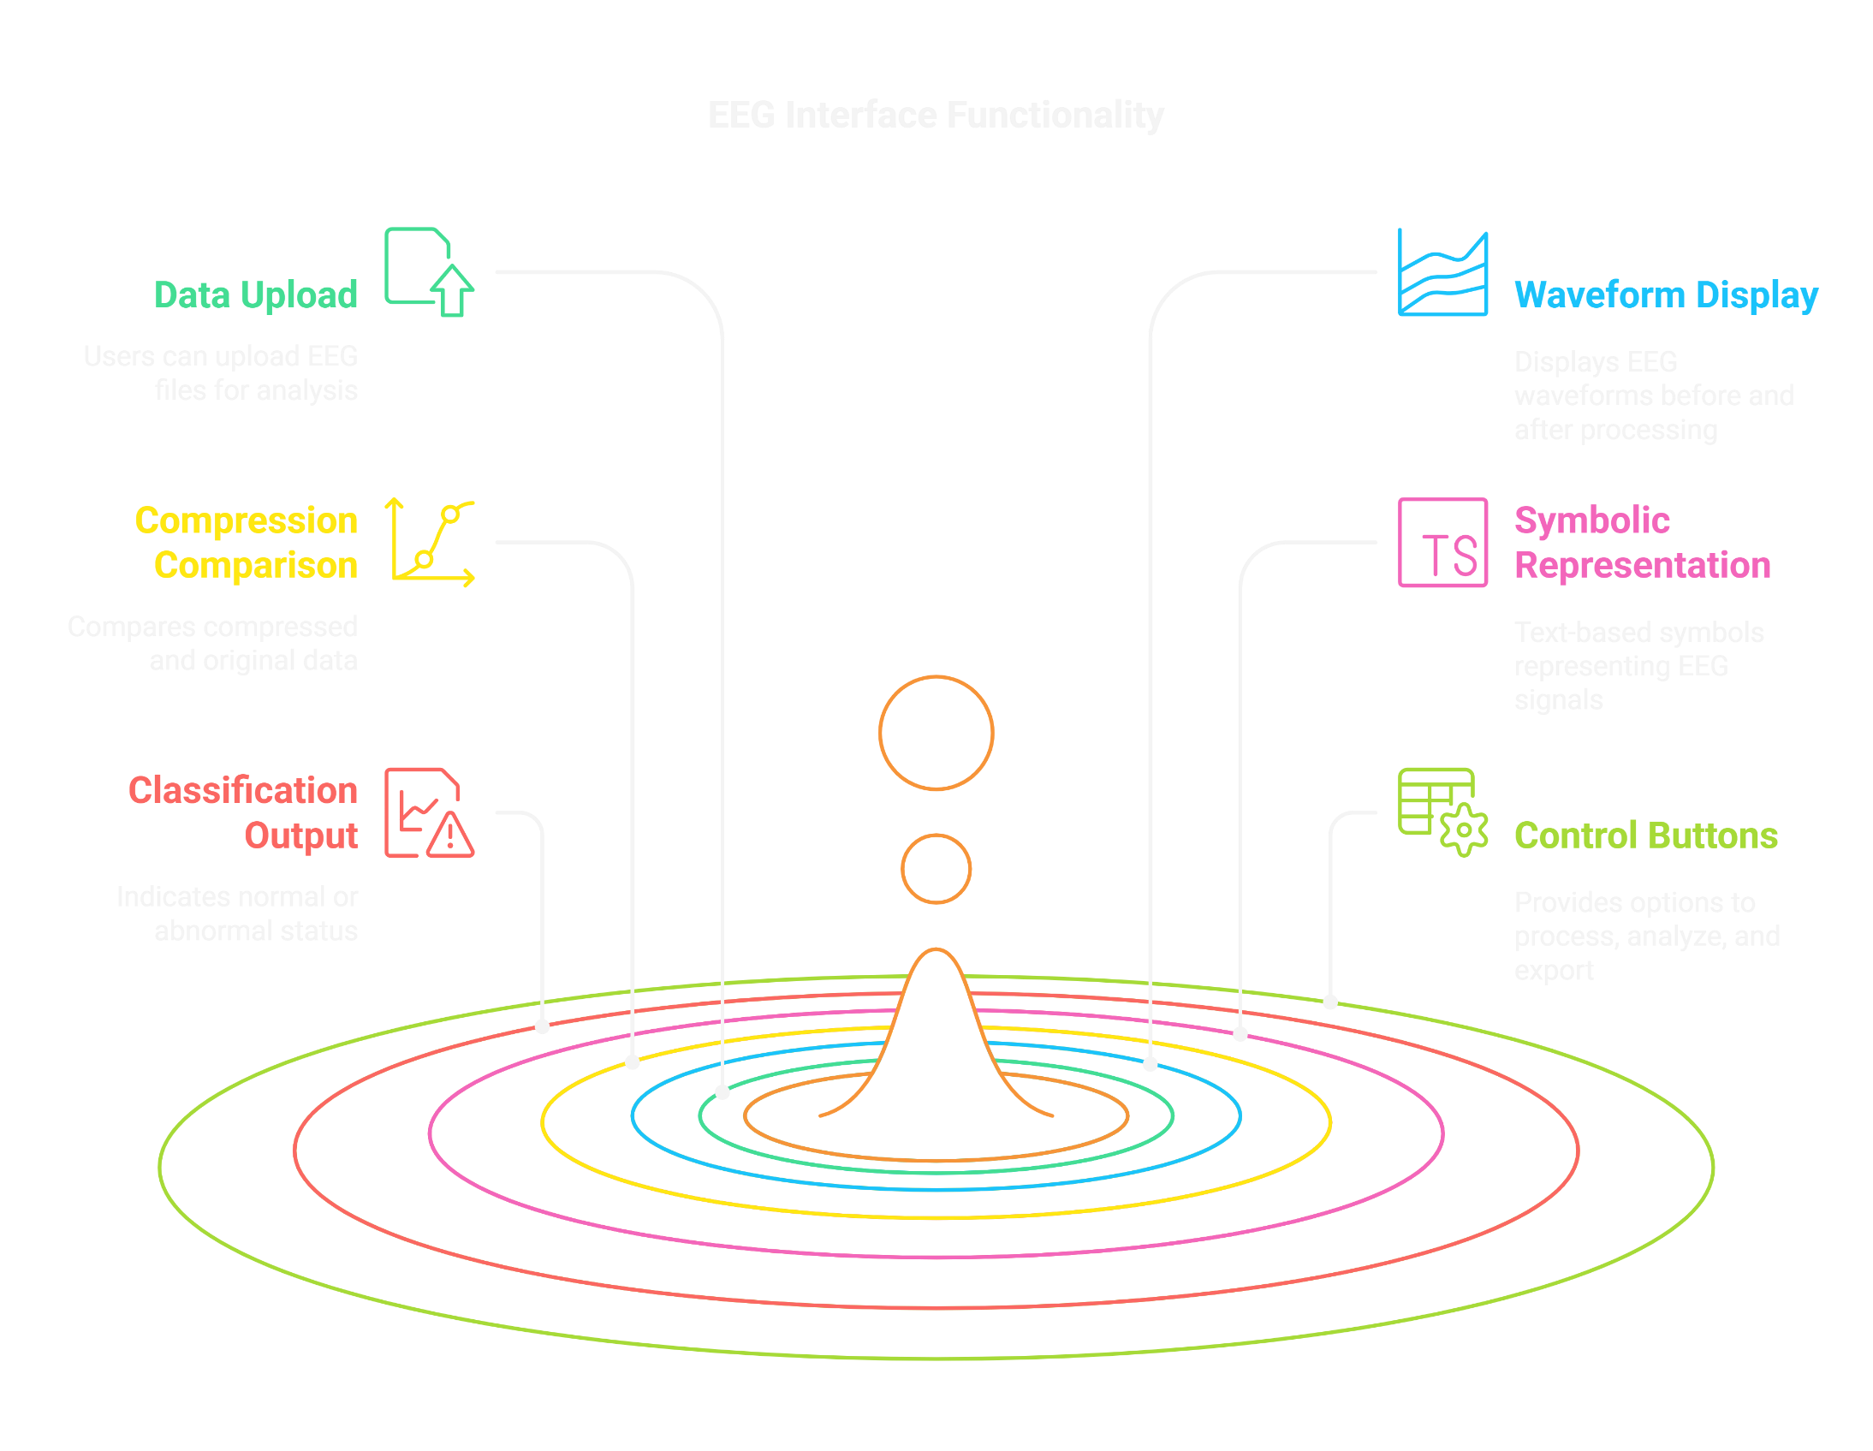
21

Slide 22
22
Anticipated Outcomes
High Accuracy:
Classifies EEG recordings with precision by identifying unique patterns.
Reduced Misdiagnoses:
Preserving raw EEG details minimizes errors in diagnosis.
Broader Applications:
Useful for medical diagnosis, cognitive research, and brain-computer interfaces.

Slide 23
23
THANK YOU
FOR YOUR ATTENTION

